Slide 1
Hypocenter Relocation Using
Geiger Method
By:
Abdullah Alali
Rami Albattat
Andika Perbawa
Instructor: Prof. Ibrahim Hoteit
ErSE 213 Inverse Problem

Slide 2
Outline
The Problem
The Physics
System Formulation
Algorithm
Forward and Inverse Modeling
Blind Test
Application in Real Data
Conclusions

Slide 3
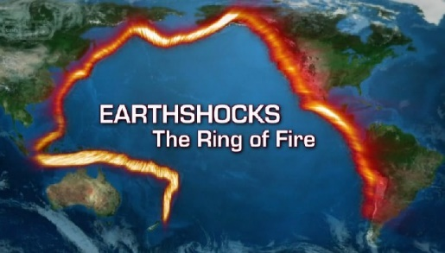
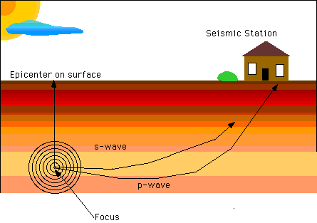
The Problem
Seismic Station
Epicenter
Hypocenter
Locating the origin of the earthquake is important for hazard assessment, prevent higher losses and for determining the weak zones

Slide 4
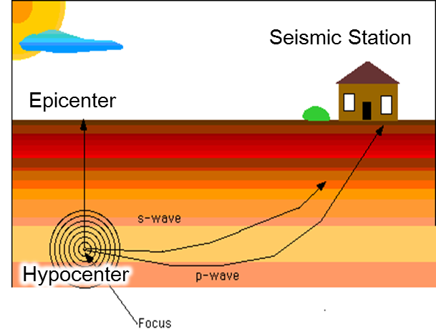

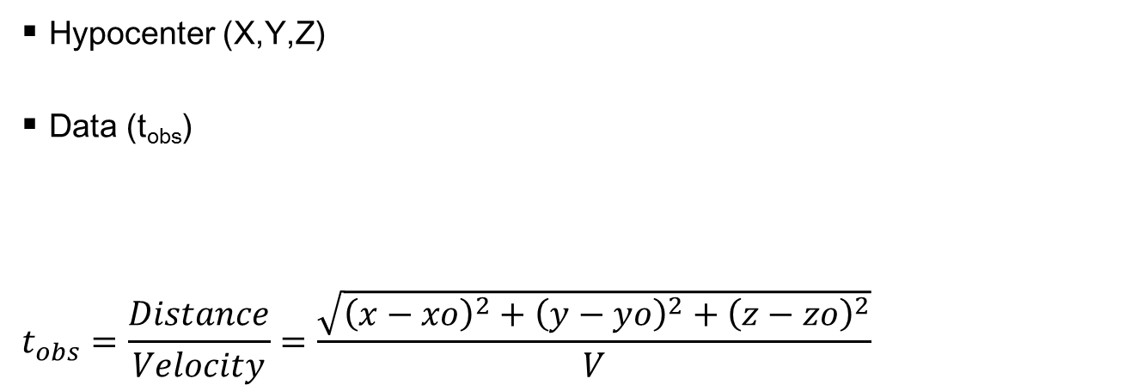

The Physics Of the Problem
Hypocenter (X,Y,Z)
Data (t_{obs})
$$t_{obs}=\frac{Distance}{Velocity}=\frac{\sqrt{{\left(x−xo\right)}^{2}+{\left(y−yo\right)}^{2}+{\left(z−zo\right)}^{2}}}{V}$$
We want to find $xo, yo, zo$

Slide 5


The Physics Of the Problem
Q: Car arrived to the city driving for half an hour with the speed of 100 km/h, where did it come from ?
A: 50 km
Q: Car arrived to the city driving at 1:30 am with the speed of 100 km/h, where and when did it come from ?

Slide 6

The Physics Of the Problem
Hypocenter (X,Y,Z, | to)
Data (t_{obs})
Arrival time = travel time + origin time
$$t_{obs}=\frac{Distance}{Velocity}=\frac{\sqrt{{\left(x−xo\right)}^{2}+{\left(y−yo\right)}^{2}+{\left(z−zo\right)}^{2}}}{V} +to$$
We want to find $xo, yo, zo,to$
This is Non-linear Problem
tobs
to
tpred

Slide 7
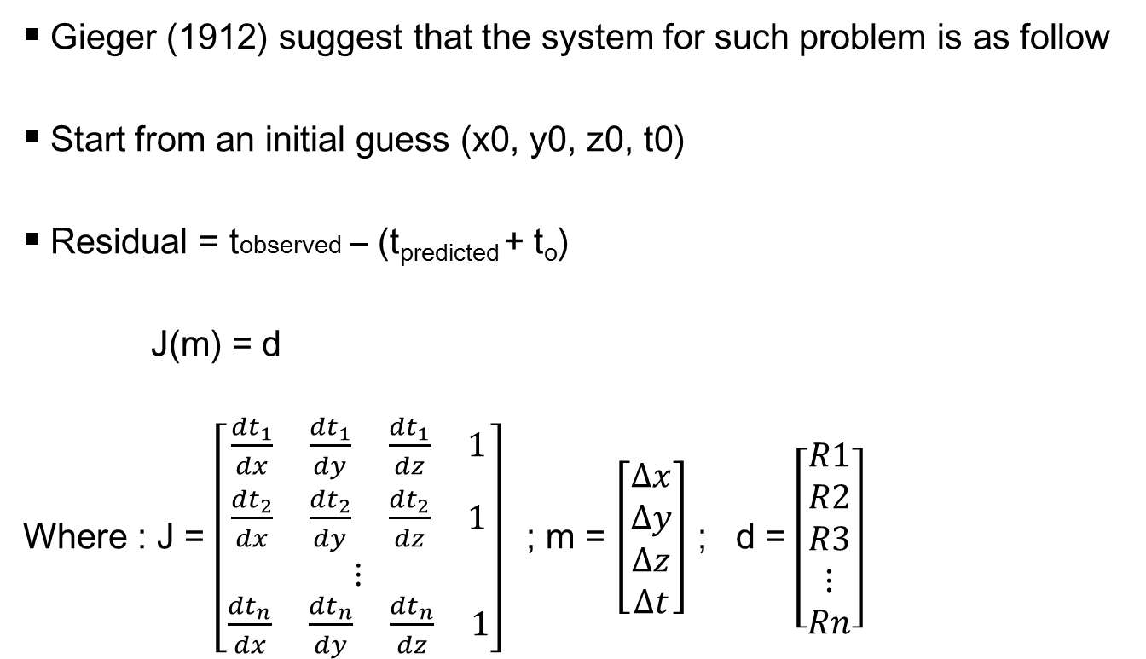
Linearizing and Forming the system
Gieger (1912) suggest that the system for such problem is as follow
Start from an initial guess (x0, y0, z0, t0)
Residual = tobserved – (t_{predicted} + t_{o})
J(m) = d
Where : J = $\left[\begin{aligned}\frac{{dt}_{1}}{dx} \frac{{dt}_{1}}{dy} \frac{{dt}_{1}}{dz} 1 \\ \frac{{dt}_{2}}{dx} \frac{{dt}_{2}}{dy} \frac{{dt}_{2}}{dz} 1 \\ ⋮ \\ \frac{{dt}_{n}}{dx} \frac{{dt}_{n}}{dy} \frac{{dt}_{n}}{dz} 1\end{aligned}\right]$; m = $\left[\begin{aligned}∆x \\ ∆y \\ ∆z \\ ∆t\end{aligned}\right]$ ; d = $\left[\begin{aligned}R1 \\ R2 \\ R3 \\ ⋮ \\ Rn\end{aligned}\right]$

Slide 8
Algorithm
Initial Model
xo,yo,zo,to
Forward modeling
t pred
R= tobs – (t pred + to)
Update
x1=x0+Δx
y1=y0+Δy
z1=z0+Δz
t1=t0+Δt
DLSQR
No
Solve Jm=d
Small ?
Yes
Final Hypocenter
X_{final}, Y_{final}, Z_{final}, to_{final}

Slide 9
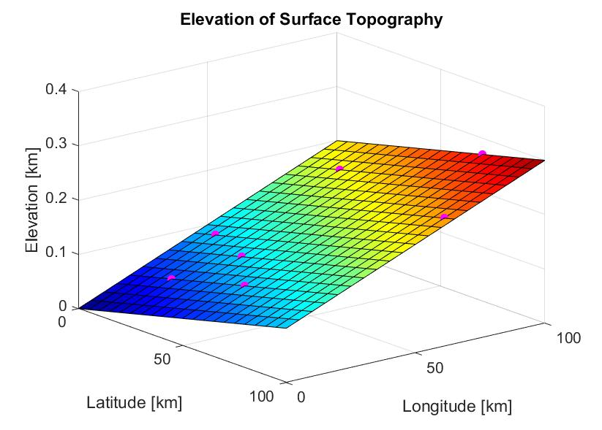

Forward Model (Synthetic)
Hypocenter location is known.
Calculating
$$t_{obs}^{}$$

Slide 10
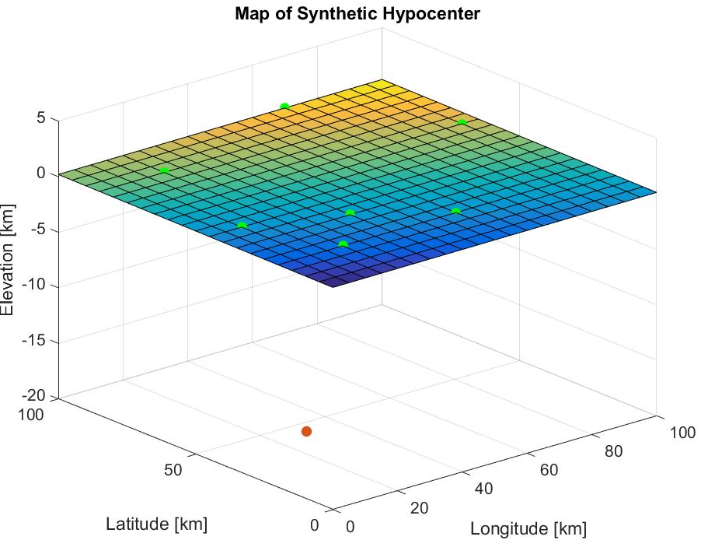

Results from forward Model
Stations “green”.
Hypocenter “red”.
Velocity is 5 km/s
7 Stations
station
1 | 15.6710
2 | 18.1334
3 | 24.1928
4 | 24.1902
5 | 14.6009
6 | 16.7154
7 | 19.1818
$t_{obs}^{}$, second
Hypocenter

Slide 11
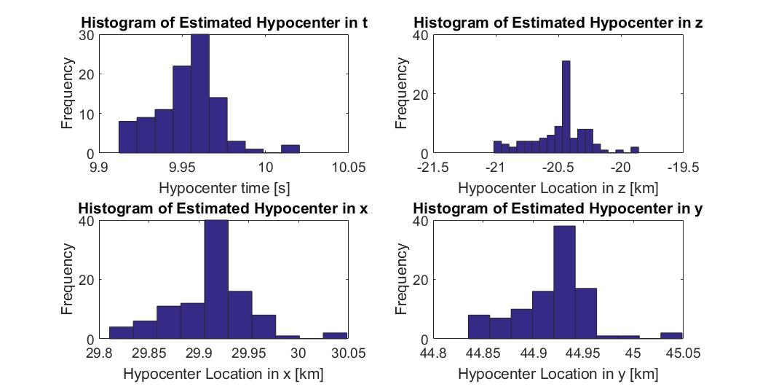
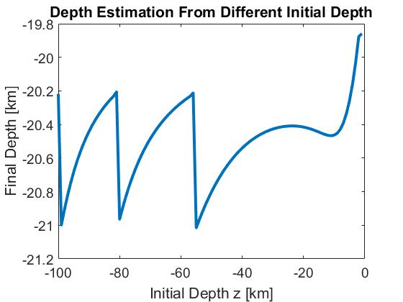

Inverse Model
Damped least square, $κ^{2}=0.001$
Higher damped factor,
higher iterations
Changing initial model
Max noise is $N(0,0.05)$ to
converge
 | Real Model | DLSQR
x | 30 km | 29.9 km
y | 45 km | 44.9 km
z | -20 km | -20.4 km
t | 10 s | 9.96 s

Slide 12
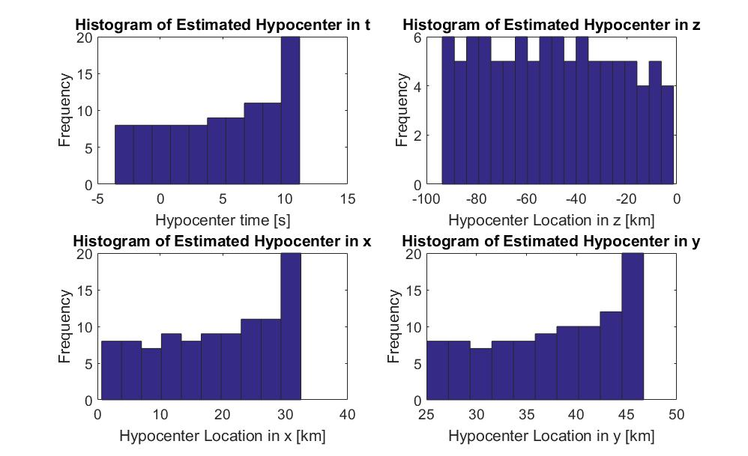
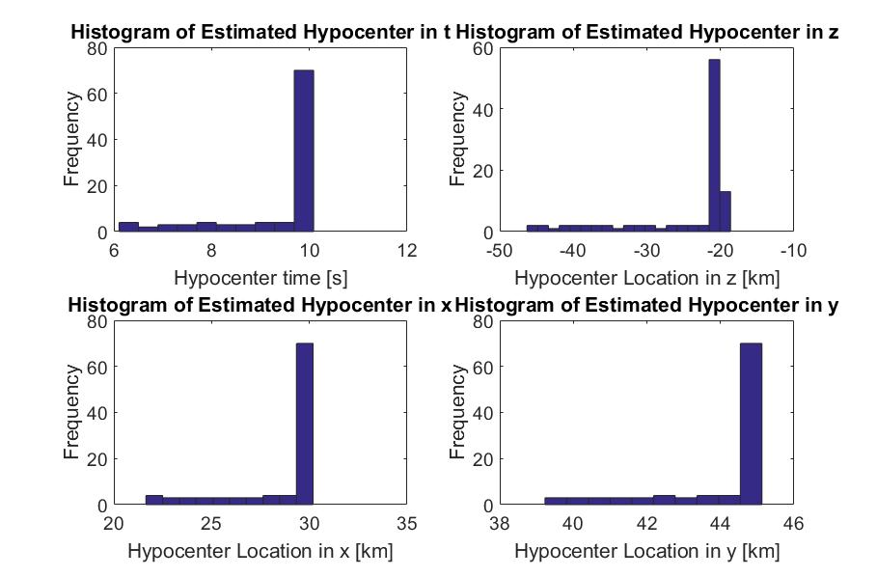
Blind Test
Removing one stations each time to see the solution.
# stations | x, km | y, km | z, km | t, s
Real | 30 | 45 | -20 | 10
6 | 29.9 | 44.9 | -20.4 | 9.96
5 | 29.8 | 44.8 | -20.7 | 9.91
4 | 30.9 | 45.6 | No solution | 10.4
4 | 29.8 | 44.8 | -20.8 | 9.89
DLSQR
WDLSQR

Slide 13
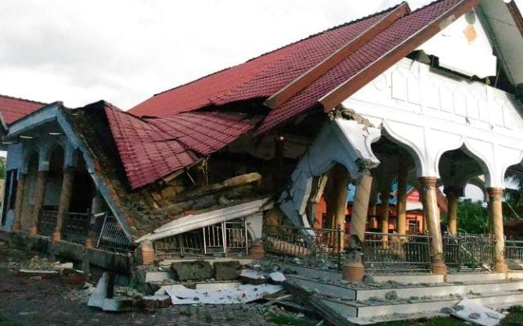
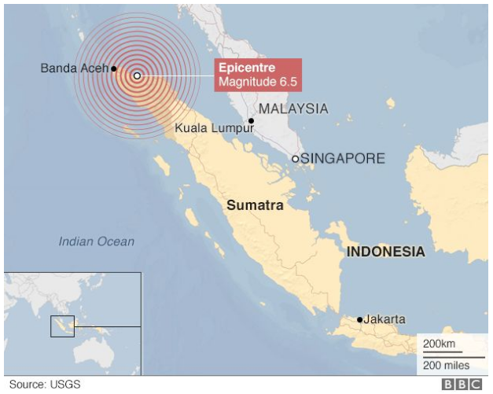
Application in Real Data
Earthquake Location
Timing: 7 December 2016 at 05:03 local time
110 km (68 miles) from the provincial capital of Banda Aceh
97 people have been killed
Hypocenter: offshore at depth of 8km

Slide 14
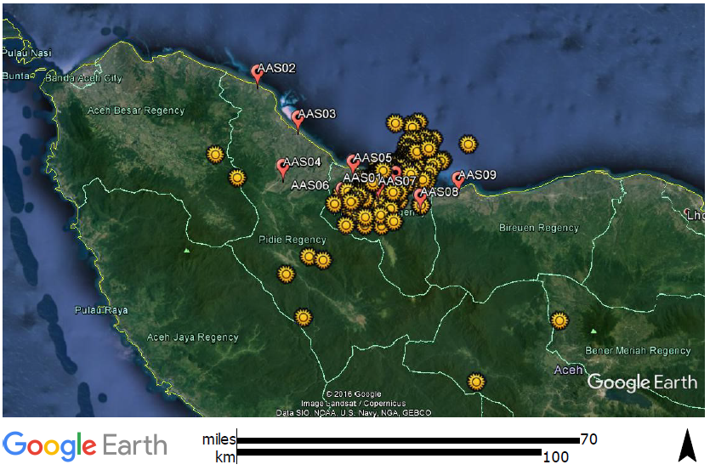

Application in Real Data
Seismic Station: 9 Stations
329 Seismicity events during December 2016 to January 2017

Slide 15
Calculation
We have one hypocenter data with details:
The time when the earthquake is about to happen is on: 11 : 07 : 03.2
Assume Vconstant = 5 Km/s. T₀ is relative to 11:07:00
Our hypocenter estimation is:
The time when the earthquake is about to happen is on: 11 : 07 : 02.88
Station | Date | Hours | Minutes | Second
ST01 | 14 December 2016 | 11 | 7 | 5.742
ST07 | 14 December 2016 | 11 | 7 | 6.466
ST08 | 14 December 2016 | 11 | 7 | 6.751
ST09 | 14 December 2016 | 11 | 7 | 8.695
ST03 | 14 December 2016 | 11 | 7 | 10.01
ST04 | 14 December 2016 | 11 | 7 | 10.215
Coordinate X | Coordinate Y | Depth (Km)
191820 | 579877 | -16
Coordinate X | Coordinate Y | Depth (Km) | T₀ (s)
191295 | 580138 | -14.77 | 2.88
Δx = 525 m | Δy = 260 m | Δz = 1.23 km | Δx = 0.32 second

Slide 16
Result
1st Iteration
Δd = 0.59 km
2nd Iteration
Δz = 1.23 Km

Slide 17
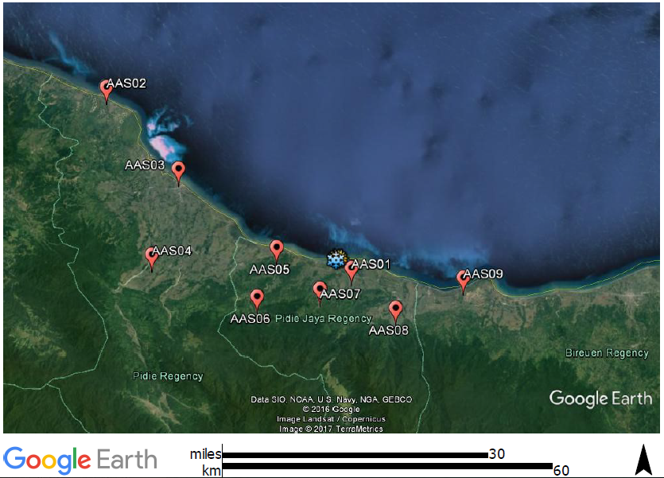
Epicenter Location
Calculated Epicenter
Reported Epicenter

Slide 18
Conclusions
The Geiger’s methods works in these following assumption:
  Constant velocity
  Straight ray-path from hypocenter to seismic station
DLSQR gives more efficient solution with less iteration compared to LSQR
Blind test shows DLSQR is feasible in over-determined case
Additional weighted in depth column is needed for even-determined case
Under-determined problem cannot be solved in our method. Need further investigation
DLSQR is applicable to estimate the hypocenter location in real data
An accurate velocity is needed to increase the accuracy and precision in hypocenter estimation
Need further investigation for varying velocity model case

Slide 19
Thank you

